Slide 1
Telangana Growth Analysis
By Samiksha Ratanlal Sonawane

Slide 2
Stakeholders
1. Kalvakuntla Taraka Rama Rao / KTR
Minister for IT, Industries and Municipal Administration:
2. Jayesh Ranjan Secretary
Information Technology (IT); Government of Telangana
3. Dileep Konatham
Director at Government of Telangana
4. Venu Panjarla
Open Data Telangana

Slide 3
CodeBasics Team
Dhaval Patel Founder CodeBasics
Hemanand Vadivel Co-founder CodeBasics

Slide 4
Project Goal
Analyse Telangana’s growth among different sectors quantitatively and provide useful Insights to the Telangana government that would help them to make data-informed decisions that would further support the growth of the state.

Slide 5


1. Objective
Explore Stamp Registration, Transportation and Ts-Ipass Datasets. Understand their attributes, categories and time period.
Analyze trends and patterns within each department.
Identify growth opportunities and areas needing attention.
Find correlation among these departments and report the overall growth of the state through insights and relevant visuals such as shape maps.

Slide 6
Findings & Insights

Slide 7
Stamp Registration
Stamp registration is the process of registering various legal documents, typically through affixing of physical stamps or payment of stamp duty to make the documents legally valid and enforceable.
E-stamp registration is a modernized and digitized form of stamp registration, where electronic stamps are used of physical paper stamps. It is often implemented through electronic means and digital signatures.
Document registration is a traditional way of registering which involves physically affixing paper stamps to documents . The process of document registration can vary by jurisdiction and the types of documents. It may involve the payment of stamp duty, verification of document details and the issuance of a registration certificate.

Slide 8
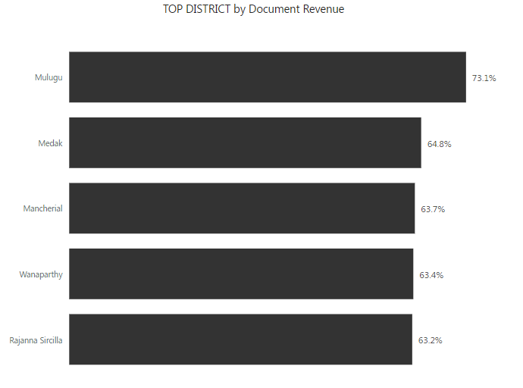
1. How does the revenue generated from document registration vary across districts in Telangana? List down the top 5 districts that showed the highest document registration revenue growth between FY 2019 and 2022.
Mulugu exhibited a remarkable 73.1%cgrowth in document registration revenue . Medak rank at second place with 64.8% revenue growth.

Slide 9
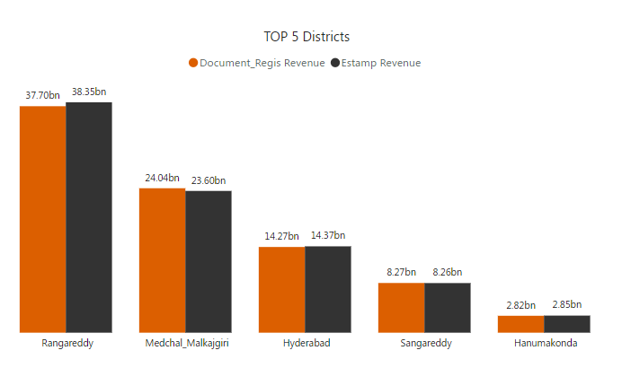
2. How does the revenue generated from document registration compare to the revenue generated from e-stamp challans across districts? List down the top 5 districts where e-stamps revenue contributes significantly more to the revenue than the documents in FY 2022?
In 2022, e-stamp revenue slightly outperformed document revenue in contributing to the total revenue.
Rangareddy led the pack with an impressive 37.70 bn in revenue from documents and an even higher 38.85 bn from e-stamp revenue.
Hanumakonda reported the lowest figures .

Slide 10
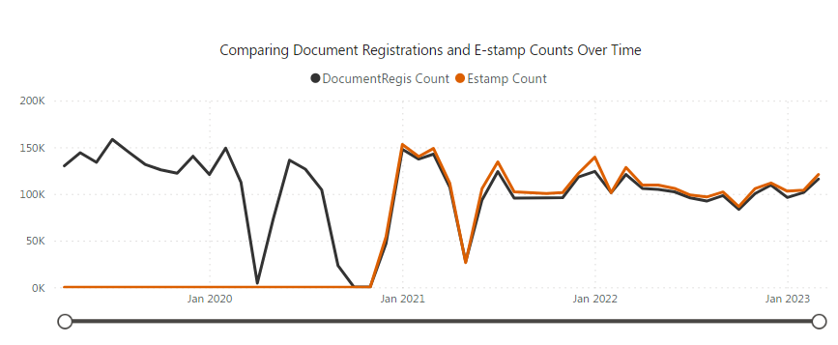
3. Is there any alteration of e-Stamp challan count and document registration count pattern since the implementation of e-Stamp challan? If so, what suggestions would you propose to the government?

Slide 11
The document registration count was consistently doing well till December 2020, primarily because e-stamp registration had not been introduced upto that point.
However, starting from December 1, 2020 when e-stamp registration was initiated, it consistently performed exceptionally well. In fact, e-stamp registration has consistently maintained a slight lead over document registration count. This shift in preference can be attributed to the convenience and safety associated with e-stamp registration, which gained even more traction during the Covid-19 pandemic.
This information highlights substantial transformation in registration methods, where the introduction of e-stamp registration has emerged as a successful and preferred option.
Interestingly, despite the rise of e-stamp registration the traditional method of document registration has not been adversely affected .

Slide 12
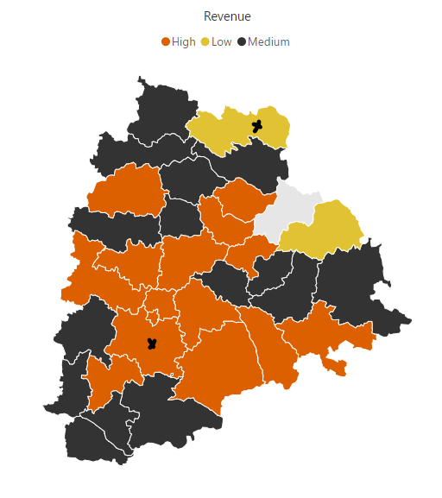
4. Categorize districts into three segments based on their stamp registration revenue generation during the fiscal year 2021 to 2022.
Kumuram Bheem Asifabad ranks in the lower segment generating lowest revenue 373 million .
Rangareddy claims top position with a staggering 189.53 billion

Slide 13
Insights
The data suggest that Mulugu has experienced substantial economic development potentially driven by property transactions or Real Estate activity, while Medak and the other regions have also shown albeit at a slightly lower rate. This could indicate a positive economic trends.
The e-stamp revenue has become increasingly significant, potentially reflecting a shift in the way transactions are recorded and the growing importance of electronic documentation. Documents registration remains a valuable revenue source across the board, despite the rise of e-stamp/ electronic documentation.
Kumuram Bheem Asifabad is the district with the lowest revenue with 37.31 crore and, Rangareddy with highest revenue from stamps with 189.53 billion .

Slide 14
Transportation Vehicle Sales

Slide 15
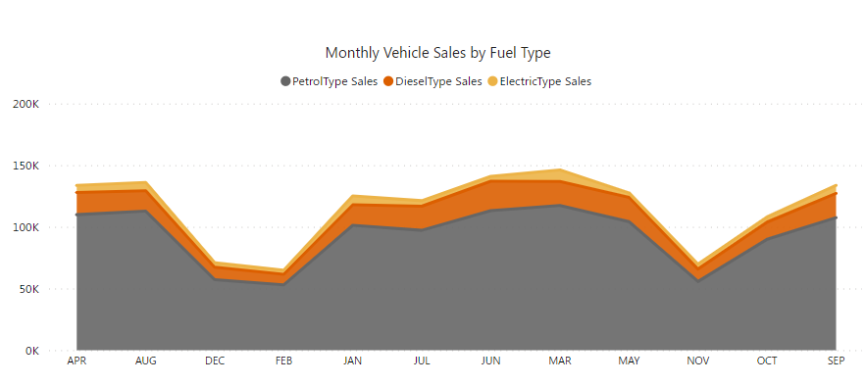
5. Investigate whether there is any correlation between vehicle sales and specific months or seasons in different districts. Are there any months or seasons that consistently show higher or lower sales rate, and if yes, what could be the driving factors? (Consider Fuel-Type category only)
Petrol type sales consistently have the highest monthly sales, followed by Diesel type and Electric type sales.
The highest petrol type sales occur in March (117,355) , while the lowest occur in November.
Diesel type sales also peak in March (19496) and lowest in February(8539).
Electric type sales have their highest point in March(9221) and lowest in February(3374).

Slide 16
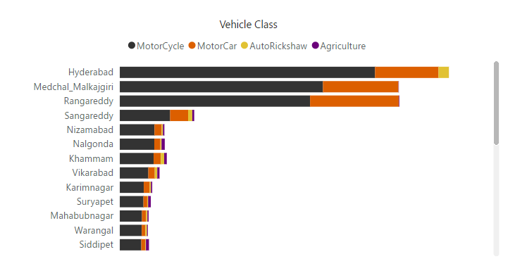
How does the distribution of vehicles vary by vehicle class (MotorCycle, MotorCar, AutoRickshaw, Agriculture) across different districts? Are there any districts with a predominant preference for a specific vehicle class? Consider FY 2022 for analysis.
Motorcycles are predominant vehicle type across all districts, being the most common choice. Hyderabad has the highest number of motorcycles with 8.54 lakh followed by Medchal_Malkajgiri and Rangareddy. Hyderabad predominantly favors motorcycles and motorcars, reflecting its urban character and higher income levels.
Nalgonda, Siddipet, Suryapet and Khammam has highest agriculture type vehicles with 2599, 2437, 2188, 2121 respectively, which aligns with the importance of agriculture in this region.

Slide 17
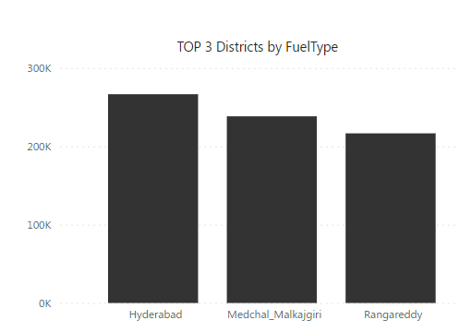
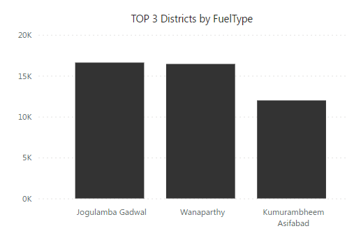
7. List down the top 3 and bottom 3 districts that have shown the highest and lowest vehicle sales growth during FY 2022 compared to FY 2021? (Consider and compare categories: Petrol, Diesel and Electric)
Year 2021

Slide 18
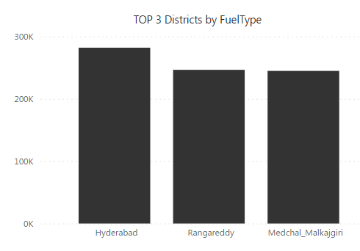
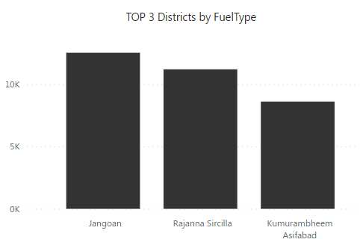
Year 2022

Slide 19
Insights
It appears that from March - July consistently has the highest sales across all three fuel types. This could be due to various factors, such as end of the financial year (as March and April has highest sales), release of new models or seasonal preferences.
There is a noticeable dip in sales in the later months of the year, particularly November, December and February. This could be attributed to the holiday season or other factors.
This data suggests that there may be seasonal and market-specific factors influencing vehicle sales. Understanding this factors is crucial for marketing strategies, inventory management and forecasting.
Kumuram Bheem Asifabad records the lowest sales across all fuel types for vehicles.
Autorickshaws, often used for short urban commutes are more prevalent in Hyderabad.
Agriculture vehicles are concentrated more in rural districts like Nalgonda, Suryapet, Siddipet Nizamabad, Warangal, indicating a stronger presence of agriculture in these areas.
The data shows that Telangana districts have higher percentage (91.01%) of non-transport vehicles compared to transport vehicles (8.99%). The higher percentage of non-transport vehicle is indeed concerning due its potential environmental impact.

Slide 20
TS-iPASS
The TS-iPASS (Telangana State Industrial Project Approval and Self Certification System) is a robust and business-friendly online platform developed by the government of Telangana, India. It is designed to streamline and expedite the process of obtaining approvals and clearances for setting up new industrial and business ventures within the state of Telangana. TS- iPASS aims to create a conducive environment for investment and economic growth by reducing bureaucratic hurdles and promoting ease of doing business in the state.

Slide 21
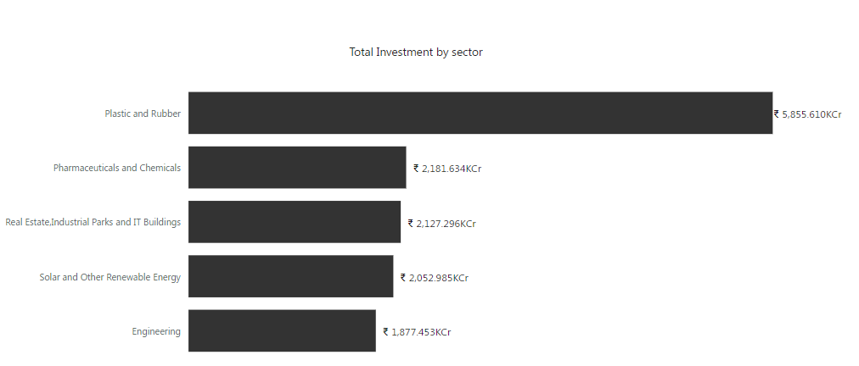
8. List down the top 5 sectors that have witnessed the most significant investments in FY 2022.
These sectors are pillars of economic development in the region, contributing to the job creation, industrial growth, technological advancement and growth of various districts in 2022.

Slide 22
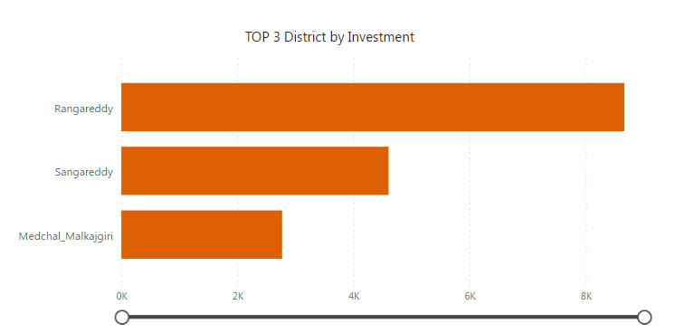
9. List down the top 3 districts that have attracted the most significant sector investments during FY 2019 to 2022? What factors could have led to the substantial investments in these particular districts?
Rangareddy is at the top with 42,706 CR Sangareddy has noteworthy investment with 12,366 CR Medchal_Malkajgiri with substantial investment of 10,394 CR.
Rangareddy, Sangareddy, Medchal_Malkajgiri appear to be the key hubs for investment, potentially contributing significantly to the state’s economic growth and development .

Slide 23
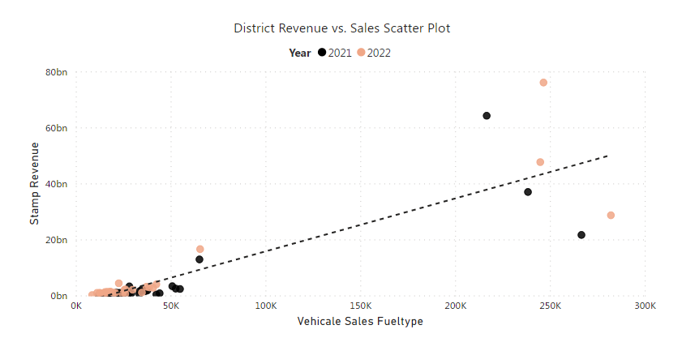
10. Is there any relationship between district investments, vehicles sales and stamps revenue within the same district between FY 2021 and 2022?
Relationship between Stamp Revenue and Vehicle sales fuel type
A linear relationship is observed between stamp revenue and vehicle sales.
As stamp revenue increases, vehicle sales also tends to increase in the district.
Higher vehicle sales and revenue suggest greater economic activity and potentially increased property transactions.

Slide 24
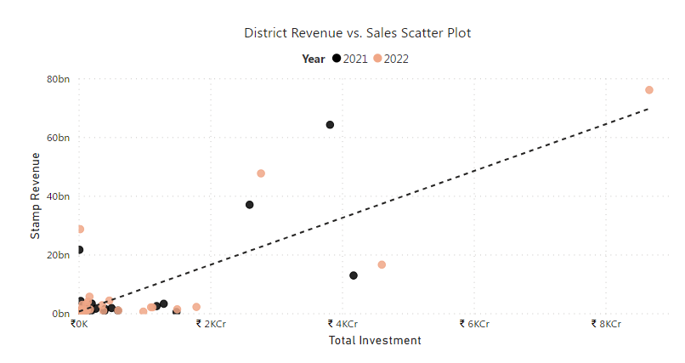
Relationship between Stamp revenue and District Investment
There appears to be a positive relationship between stamp revenue and district investment.As investment increased, stamp revenue also showed an upward trend. Higher district investments may result in infrastructure development, industrial projects, urbanization, which can stimulate the real estate sector and property transactions, subsequently boosting stamp revenue.

Slide 25
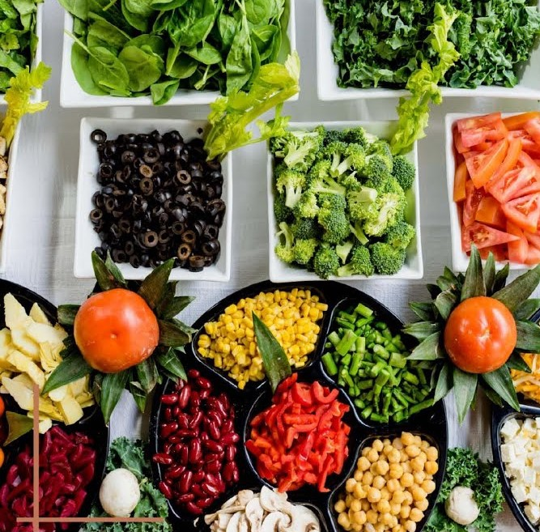



Can we identify any seasonal patterns or cyclicality in the investment trends for specific sectors? Do certain sectors experience higher investments during particular months?
Food Processing industries has significant investments in Rangareddy, Sangareddy, Nalgonda. Investments in food processing may increase during harvest season. Interestingly, the data shows that investments in this sector peak in March with the highest 549 cr, followed by November & December.
Pharmaceuticals & Chemical ,This sector has shown significant investment in Rangareddy, Sangareddy, Medchal Malkajgiri reflecting its promising growth.The highest investment was recorded in July, reaching 2807 cr, followed by September with 2139 and then December, February. This seasonal trend may reflect industry-specific factors & investment strategies influenced by market dynamics.
Real Estate, Industrial Park, IT Buildings
Has highest investments in Rangareddy, Medchal Malkajgiri. Investments in this sector show a peak in February totaling 17843 cr, followed by March. This suggest that investors may strategically allocate funds during specific months, likely influenced by dynamics & project timelines.
Engineering sector has significant investments in Rangareddy, Sangareddy, Medchal Malkajgiri and Medak. It may see fluctuations investment activities based on product release.Data reveals Investments in this sector are higher in February reaching 1332 cr & October totaling 688 cr.

Slide 26
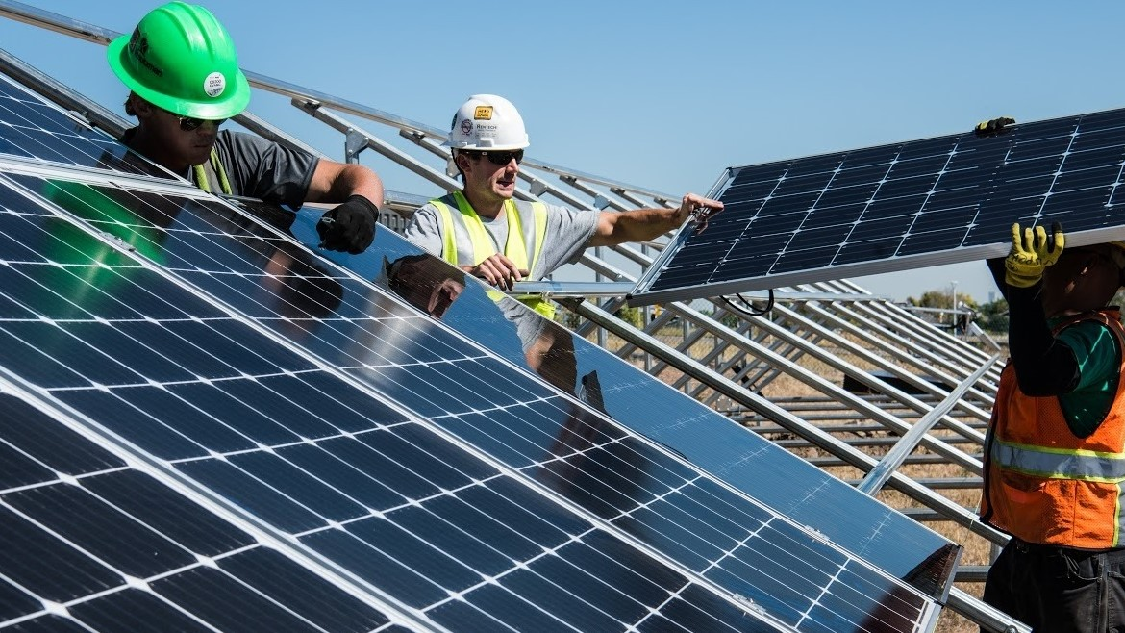
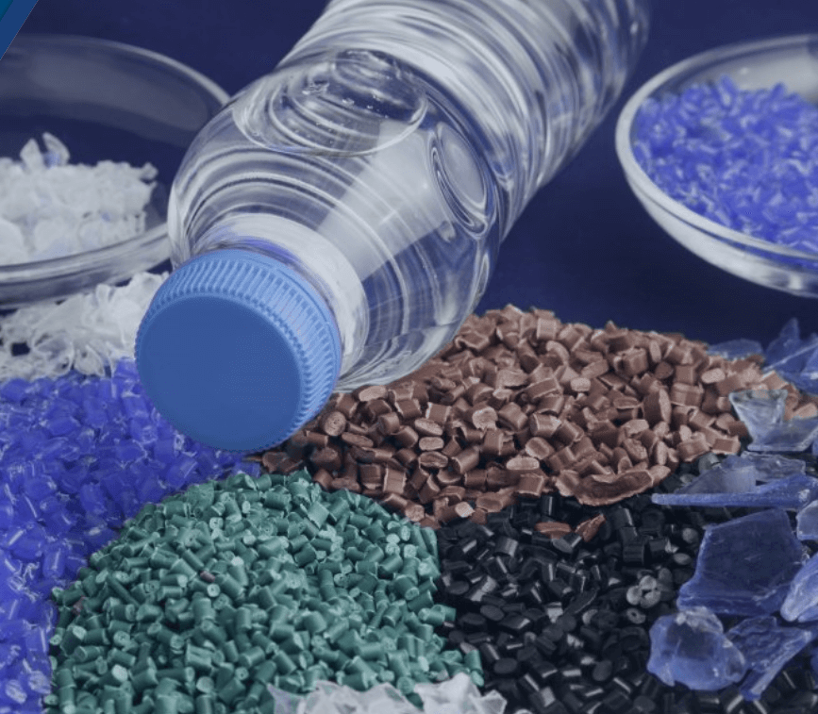
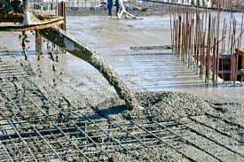
Solar & other Renewable Energy sector has significant investments in Mahabubnagar, Medak, Kamareddy, Mancherial. Investments in this sector vary significantly. The highest recorded investments in this sector were in November, totaling 2008 cr, followed by April with 1202 cr. This pattern suggests that investors closely align their funding with project launch and market conditions in the renewable energy sector.
Plastic & Rubber sector has attracted significant investments in Rangareddy, Sangareddy with 4993 & 3434 crore respectively.Interestingly, Investments in this sector follow a distinct pattern, reaching a peak in December with 1958 cr, followed by Jan with 1803 & Aug. This pattern may be influenced by various factors, including industry trends, seasonal demands & investor strategies.
Cement, Concrete Products & Fly Ash Bricks sector boasts the highest investments in Suryapet, followed by Rangareddy. Interestingly, the sector experiences its highest investment peak in August, reaching 977 cr. It exhibit a relatively stable trend but tend to have highest values in Feb & Aug. It suggest a well-established and steady pattern in the sector’s financial activities.

Slide 27
Secondary Research

Slide 28
1. What are the top districts to buy commercial properties in Telangana? Justify your answer.
Hyderabad, the state’s capital, is a major economic and business hub in Telangana.The presence of a large population, numerous businesses, IT companies, and commercial centers makes it the top choice for commercial property investment.
Rangareddy district benefits from its proximity to Hyderabad. It has witnessed urban expansion and infrastructure development, making it an attractive location for commercial investments.
Medchal_Malkajgiri, being part of the Greater Hyderabad area, is a thriving district with substantial investment. It hosts a substantial number of businesses, including IT and industrial sectors, making it an attractive location for commercial properties.
Sangareddy district shows promise as a location for commercial property investment due to its diverse economic activity and significant investment.

Slide 29
2. What significant policies or initiatives were put into effect to enhance economic growth, investments, and employment in Telangana by the current government?
The Telangana government had launched several initiatives to promote industrialization and investments in the state, including the Telangana State Industrial Project Approval and Self-Certification System (TS-iPASS), which aimed to simplify and expedite the approval process for setting up industries.
Telangana introduced several agriculture support schemes to boost the rural economy, including Rythu Bandhu, which provided direct financial assistance to farmers and Rythu Bima an insurance scheme for farmers. These initiatives aimed to enhance agriculture productivity and income.
The state has made strides in renewable energy with a focus on solar power generation. Policies promoting clean energy sources have been implemented.

Slide 30
Recommendations

Slide 31
Recommended Actions
Promote Awareness - Launch an awareness campaign to educate the public and businesses about the benefits of e-stamp registration, including its convenience and time-saving advantages.
Online Tutorials and Support - Provide online tutorials and customer support services to assist users in navigating the e-stamp registration process effectively.
Subsidies and Incentives - The Telangana government can provide subsidies and incentives for the purchase of agriculture vehicles. This can include reducing the cost of acquisition, offering lower interest rates on loans, or providing tax benefits to buyers.
Establishing government-operated or subsidized rental services for agriculture vehicles. This allows farmers who cannot afford to purchase their own vehicles to still access them when needed.
Launch public awareness campaigns to educate both urban and rural populations about the environmental impact of excessive non-transport vehicle usage. Highlight the benefits of using public transportation, carpooling, and adopting eco-friendly agriculture practices.
Invest in infrastructure – Continue investing in infrastructure development, especially in and around Hyderabad. Enhancing connectivity, public transportation & digital infrastructure will attract more businesses.

Slide 32
7. Identify key sectors with growth potential in each district and tailor incentives and policies to attract investments in those sectors. For instance, promote IT in Hyderabad and agriculture business in district with agriculture potential such as Nalgonda, Suryapet , Khammam.
8. Invest in skill development and workforce training programs to ensure a skilled labor force. This will make the state more attractive to industries and businesses.
9. Implement Vehicle Emissions Standards, enforce strict emissions standards for all vehicles, including non-transport ones, to reduce their environmental impact.
10. Incentivize Electric Vehicles(EVs), offer incentives and subsidies to promote the adoption of electric non-transport vehicles, which have a significantly lower environmental footprint compared to traditional vehicles.

Slide 33
Thank You

